Slide 1
StrokeShield Analytics
Identifying Stroke Risk to Enable Preventive Care
Tyler Patton, Madeleine Gomez, Rian Kahlon
Notes:
(Tyler) Hello everyone, thank you for having us. We’re from the StrokeShield Analytics data science consulting team focused on turning healthcare data into actionable prevention strategies. Today, we’ll walk you through what we learned from your patient data, the risks we identified, and the data quality issues you’ll want to address before building a stroke prediction model.

Slide 2
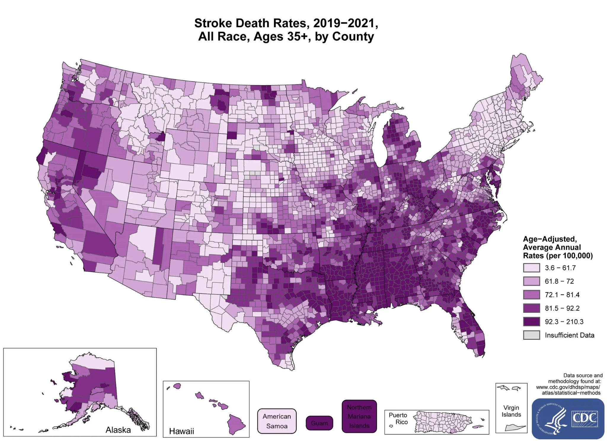
Why This Matters
Notes:
( Rian) Stroke is not only a major cause of death — it’s also one of the most preventable major health events. For insurers, this creates a huge opportunity: identifying high-risk members early allows for targeted interventions that reduce both human and financial costs. Before building any predictive model, though, we must first focus on understanding the data and making sure it will not mislead us.

Slide 3
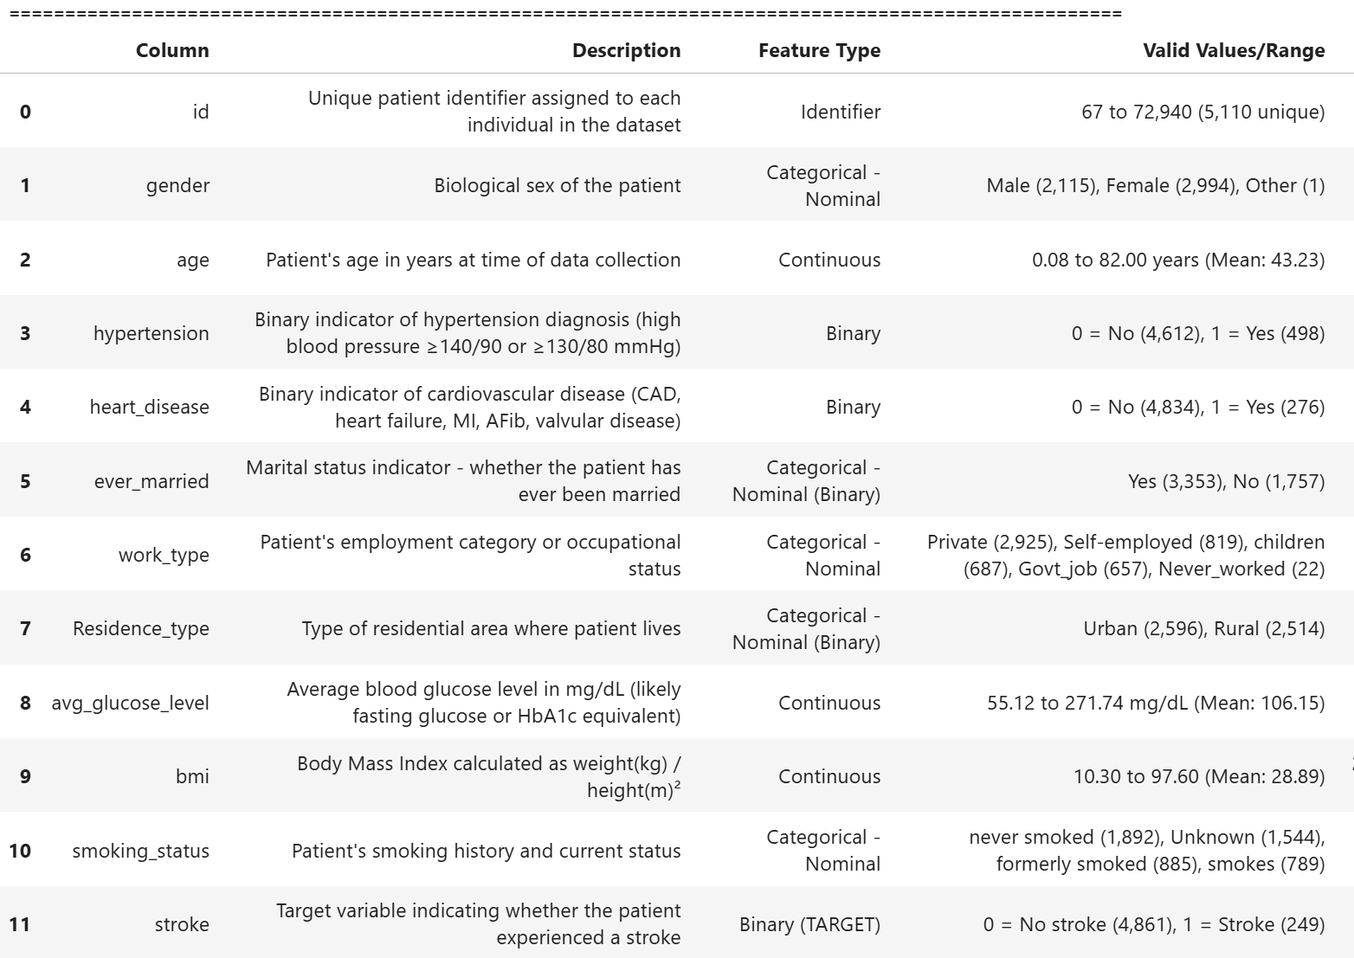
Dataset Overview
Notes:
(Madeleine) The dataset includes individual patient records with 11 different features, including demographic and clinical risk factors such as age, BMI, hypertension, heart disease, and smoking status, as well as a binary stroke outcome.

Slide 4
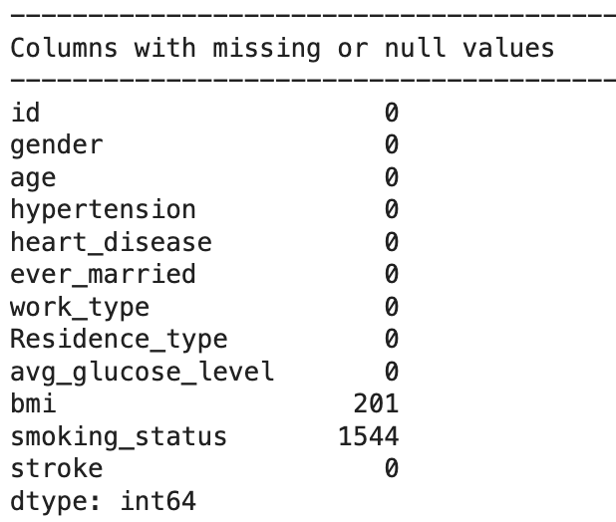
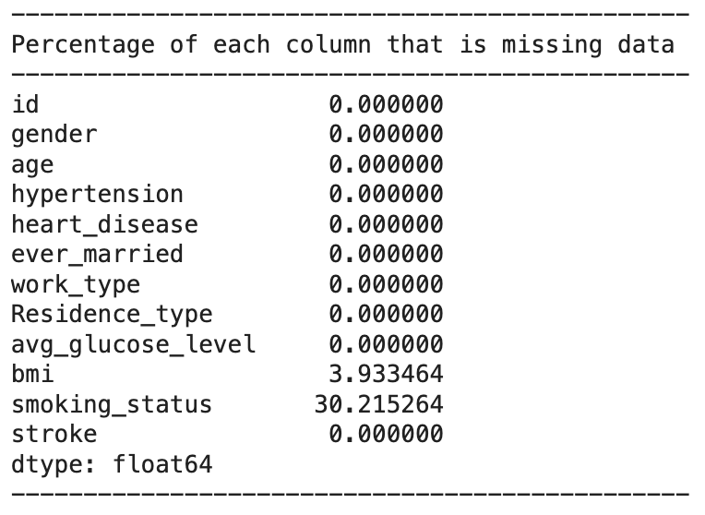
Addressing Data Quality Concerns
“Unknown” in Smoking Status column–missing data or valid category?
BMI column contains missing values as well
Checked for impossible values
Notes:
(Rian) Right away, we noticed a major modeling challenge in the form of the “Unknown” smoking status. When looking at the data card on Kaggle, “Unknown” was used to signify that the information was unavailable for the patient. Therefore, we must treat all instances of “Unknown” as missing data. As such, we converted all the “Unknown” values to null for the rest of our analysis. We then found that the smoking status column contains 1544 null values, which is approximately 30% of the entire column. Therefore, we cannot reliably assess smoking status as a factor of stroke risk, given that we are missing such a large portion of the data.
Additionally, the BMI column contains 201 null values which is approximately 4% of the entire column. This is also missing data, but as Python/NumPy automatically handle NaN values and only a small portion of this data is absent, we can still proceed with analysis.
We also checked for impossible values and found non. There are ages like 1.24 and 0.74, but these represent a clinical convention for reporting age. For example, 0.72 years means that the patient is approximately 8.6 months old. These ages essentially provide an accurate age representation of minors.

Slide 5
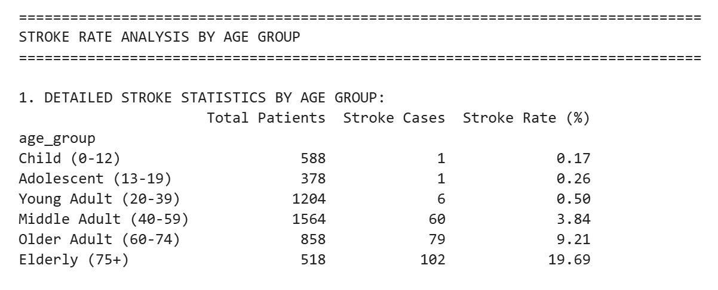
Stroke Rate Analysis By Life Stage
Uneven bin sizes.
Stroke rates tend to remain very low in early life stages
The jump between Young Adult and Middle Adult groups (age 40) is the most dramatic.
Good for communicating risk to a general audience.
Notes:
(Tyler) We first tried to break down the data by sectioning it into commonly recognized life stage groups. Stroke rates tend to remain very low in early life stages, increase moderately in middle adulthood, and then rise sharply in older adulthood. The jump between Young Adult and Middle Adult groups (age 40) is the most dramatic, increasing by a factor of about 8. Good for communicating risk to a general audience.

Slide 6
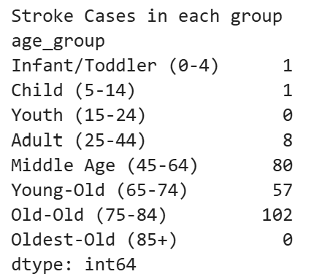
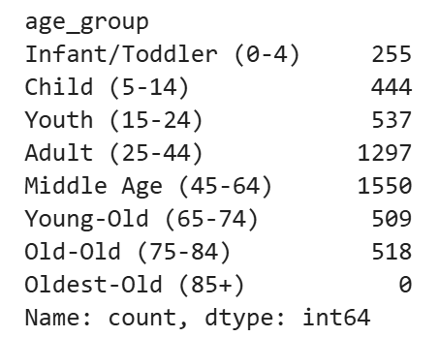
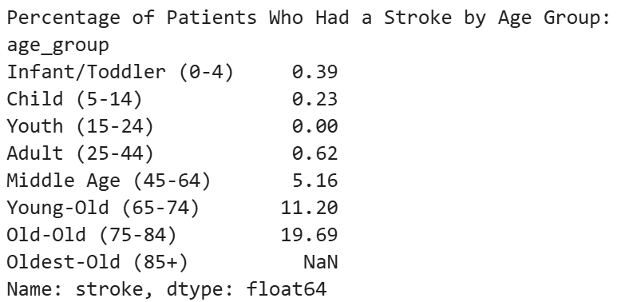
Stroke Rate Analysis WHO Standard Age Categories
Groups have clinical meaning
Bin sizes better suited for rapidly changing children.
Uneven bin-sizes
Broader adult categories
Notes:
(Rian) We then tried using the World Health Organization standard for age classification. This would allow us to use groups with more serious clinical meaning. As you can see, the results give use more accurate findings for younger age groups, although it should be noted that in this data set there are still only 1 stroke case in each of the two beginning young groups. Overall this is quite similar to the last age grouping, although we did find the older age groupings to be a little more robust, it still has many of the same issues, especially for older age groups, still having uneven bin distribution and broad adult categories. We still felt we could do better, which leads us to our final age grouping.

Slide 7
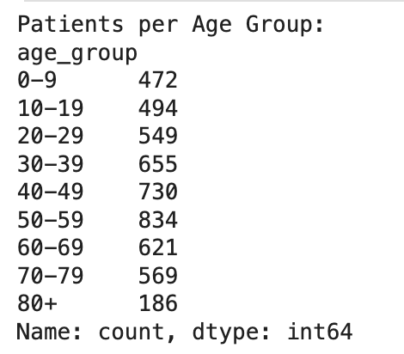
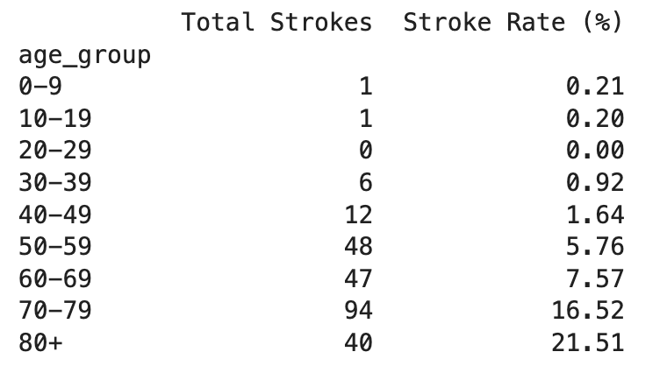
Stroke Rate Analysis By Decade
Key findings:
Even bin sizes
Stroke rate exceeds 5% at 50-59
Stroke rate exceeds 10% at 60-69
Notes:
(Madeleine) When organizing age into decade-based categories, we can obtain a more nuanced understanding of stroke rate over the years. There remains an observable increase in stroke cases beginning in the 50-59 category; however, it gradually increases as age progresses, unlike what is seen in the other two age-grouping methods.
Ultimately, we decided to go with the decade-based grouping analysis because:
Decade-based categories have more evenly distributed sample sizes, reducing class imbalance.
A larger number of smaller bins provides a more detailed view of the data, and is therefore best for analytical precision.

Slide 8
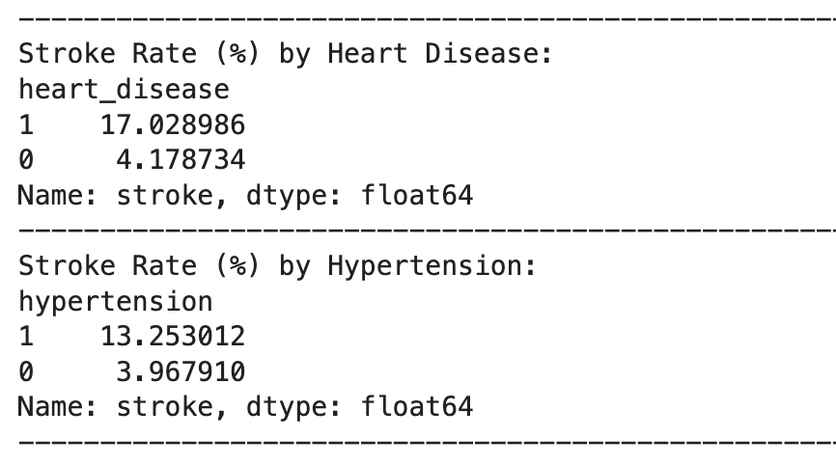
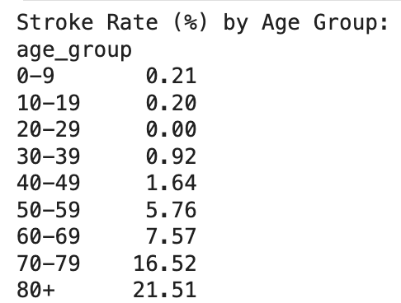
Strongest Risk Factors
Age - unmodifiable
Heart disease - depends (unmodifiable/modifiable)
Hypertension - modifiable
Notes:
(Tyler)

Slide 9
Recommendation:
Prevention programs should target individuals in their late forties to early fifties
Notes:
(Madeleine)
Limitations
There are significantly more non-stroke cases (95%) than stroke cases (5%), which makes this dataset severely imbalanced. This negatively impacts any predictive model trained on this data, because it could become deceptively accurate.

Slide 10
THANK YOU!

